Slide 1

Introduction to
User Experience (UX)
Monirul Islam
Senior UI/UX Designer @ Bit Mascot

Slide 2

Definition
What is User Experience Design?
User experience design is the process of enhancing user satisfaction with a product by improving the usability, accessibility and desirability provided in the interaction between the user and the product.
By Wikipedia

Slide 3
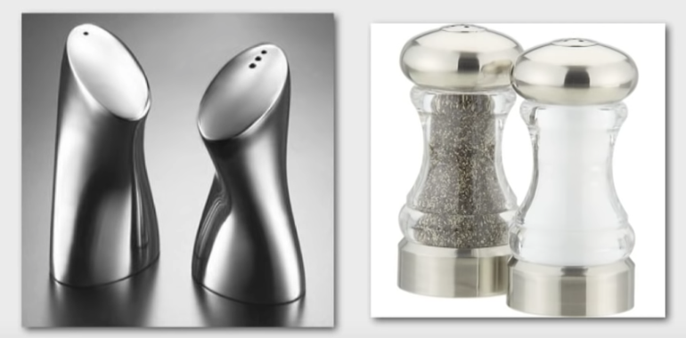
What is
What is User Experience Design?
1
Usability It refers to how easily a user interacts with a website/product to complete a task.
2
Accessibility How easy is it find the information or the content that we are presenting to users.
Desirability Provides user with an enjoyable experience as they’re doing so.
3

Slide 4
What is
What is User Experience Design?
1
Usability It refers to how easily a user interacts with a website/product to complete a task.
2
Accessibility How easy is it find the information or the content that we are presenting to users.
Desirability Provides user with an enjoyable experience as they’re doing so.
3

Slide 5
Whose responsibility?
Great User Experience is everyone’s responsibility. Because we need to balance the business need & Technology with THE NEED OF PEOPLE

Slide 6

Why UX Design is Important?

Slide 7


Business Success
01
Why UX design is important?
UX helps to perform user's need. It aims to provide positive experience that keep the user loyal to the product or brand and this helps to achieve business goal.

Slide 8


Users Problems
02
Why UX design is important?
UX design helps us to understand deeply users in order to solve their problems and examine your design beyond technical function.
Part of UX process we are studying users behaviour, asking questions about their preferences, we can create best experience.

Slide 9
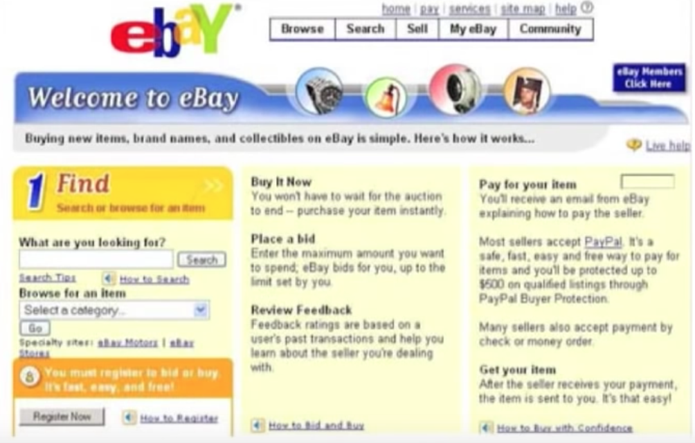
ebay
Why UX design is important?
ebay website had pretty big site back then. An American multinational e-commerce corporation.

Slide 10

Better ROI
03
Why UX design is important?
A business conversion rates will up when we have an efficient UX design. Conversion in when visitors are turned into customers. When your design responds to the visitors needs and responds to their problem, they can likely purchase.
For every £1 spent on design, businesses see a £4 increase in net operating profit.
Source: UK Design Council

Slide 11
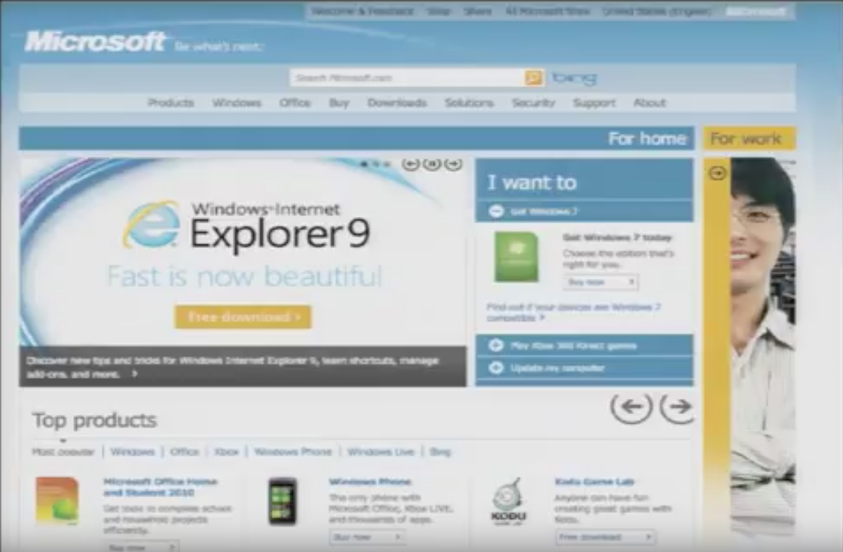
Microsoft
Why UX design is important?
Microsoft has millions of pages of information. They had products, Business software, Entertainment, Windows, Office, games and so on.. They also had entire Downloads Marketplace

Slide 12
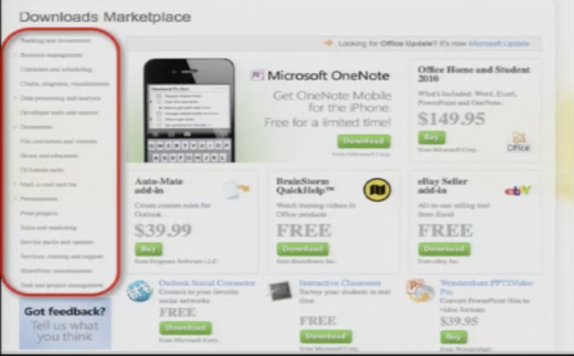
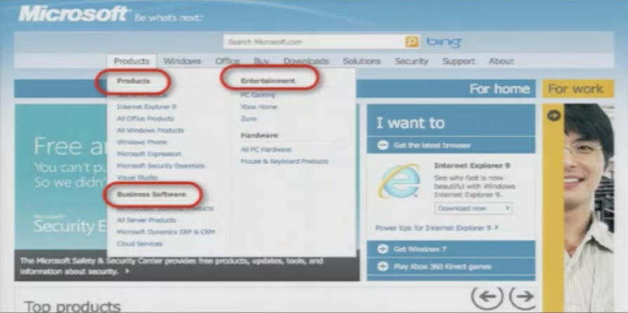
Why UX design is important?

Slide 13

Why UX design is important?

Slide 14
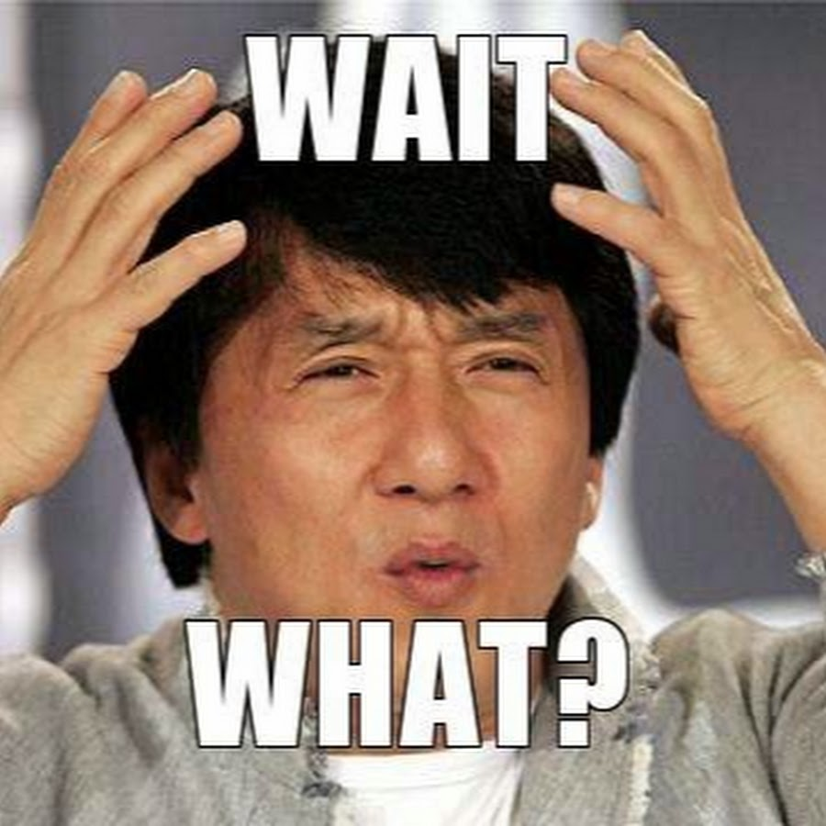
800,000
of Microsoft’s pages have never been loaded from the server!

Slide 15
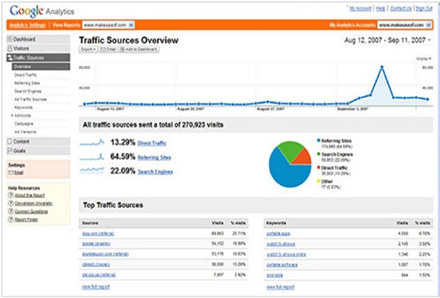
So what we should look for first?
Visitor traffic and server logs
Conversion funnels
Search engine logs (Web Analytics)

Slide 16

UX Myths...

Slide 17

UX Myths...
UX ≠ UI
User Experience
User Interface
How it works and feels?
How it looks?

Slide 18
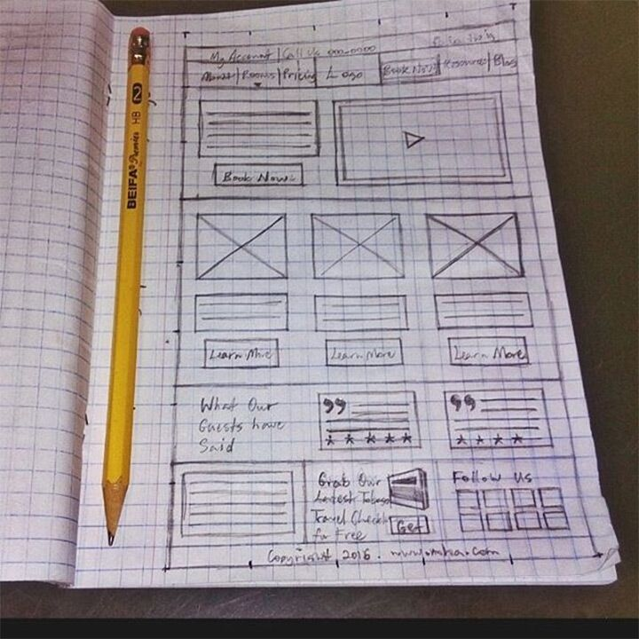
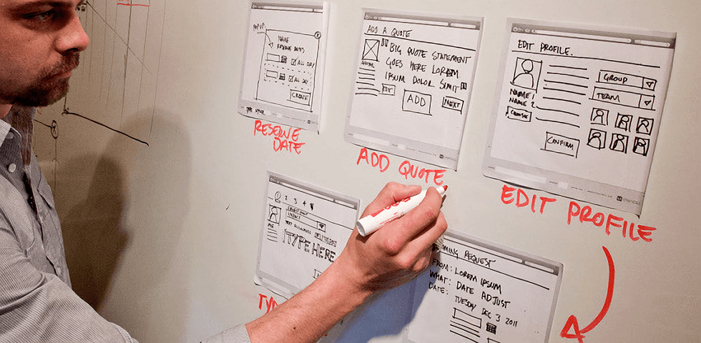
UX, They’re the people that only do wireframes
UX Myths...

Slide 19
Component of
User Experience

Slide 20
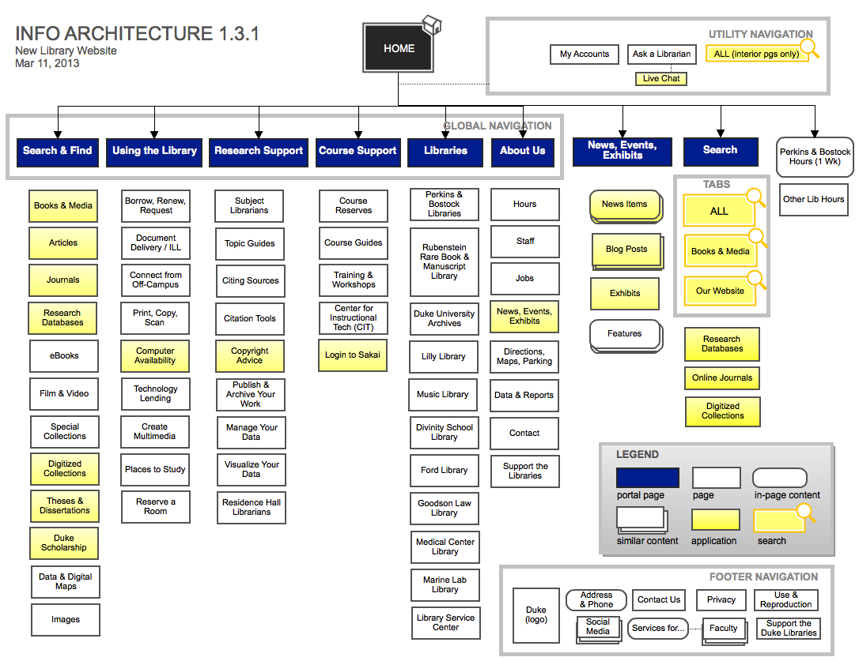
Information
Architecture
Component of User Experience
Combination of organization, labeling, and navigation schemes
Blueprint of the design structure
Poor navigation cause 80% usability problem
Source: https://www.toptal.com/

Slide 21
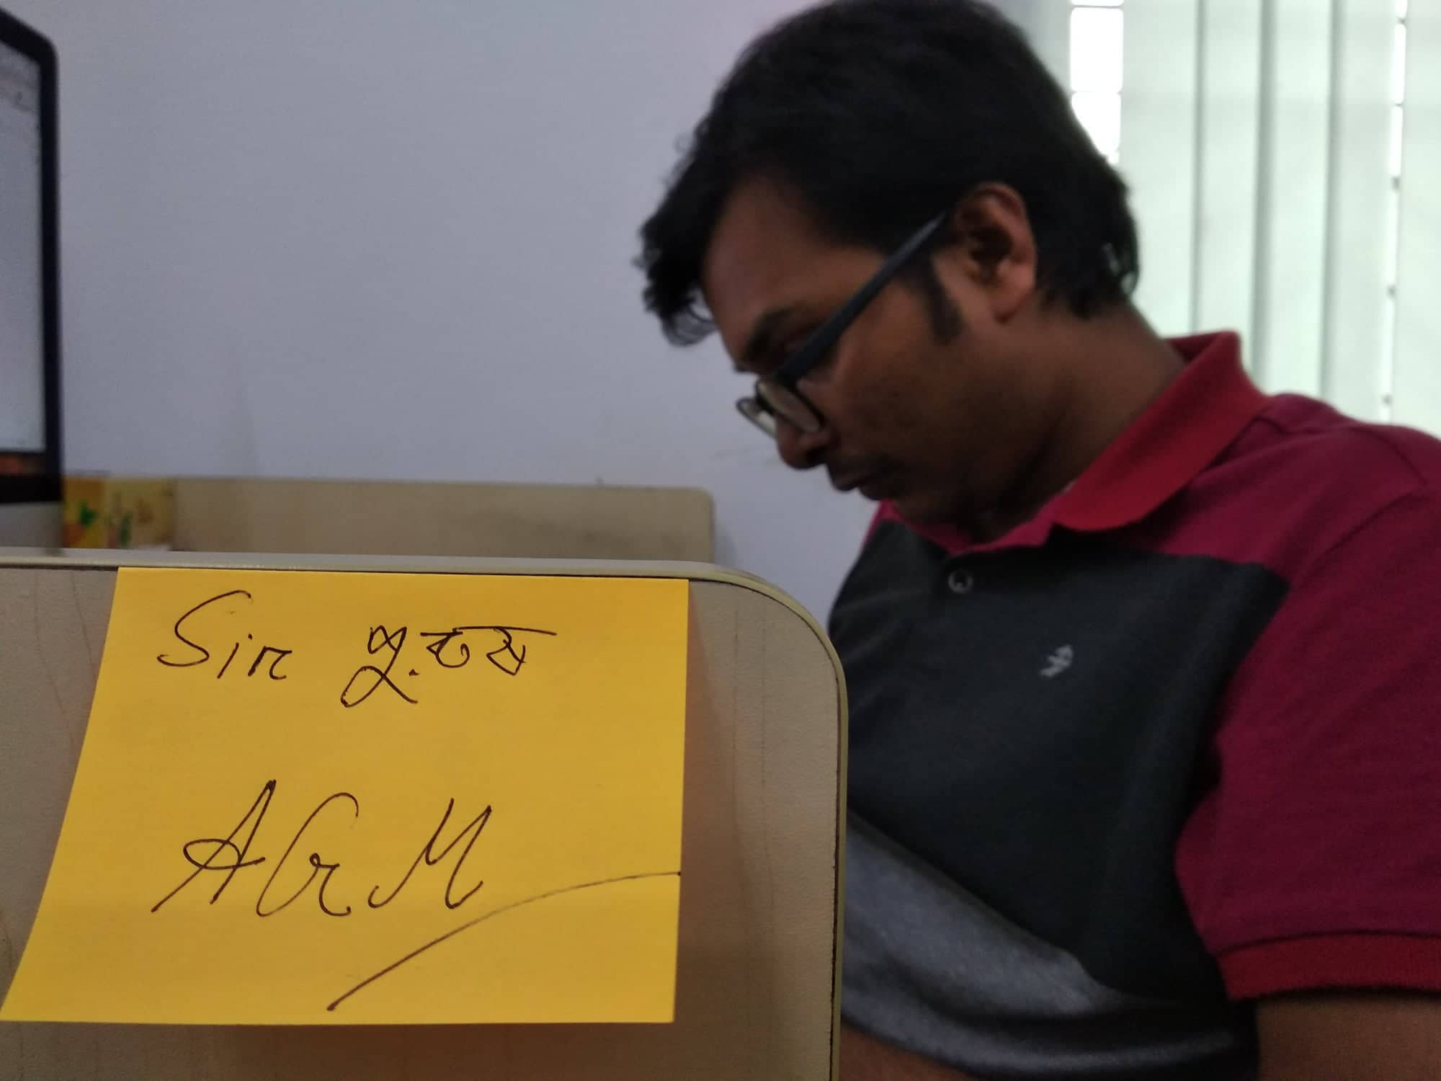
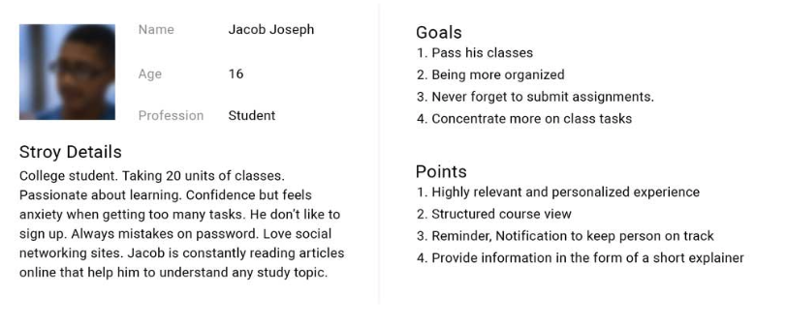
Usability
Component of User Experience
Deals with gathered data to determine the validity of design
Data gathered by - understanding the needs of user and their environment
Profiles and Personas

Slide 22
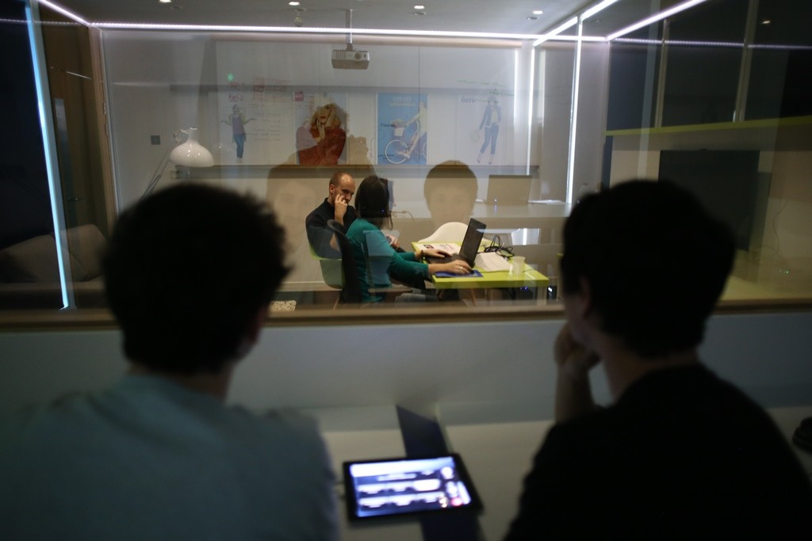
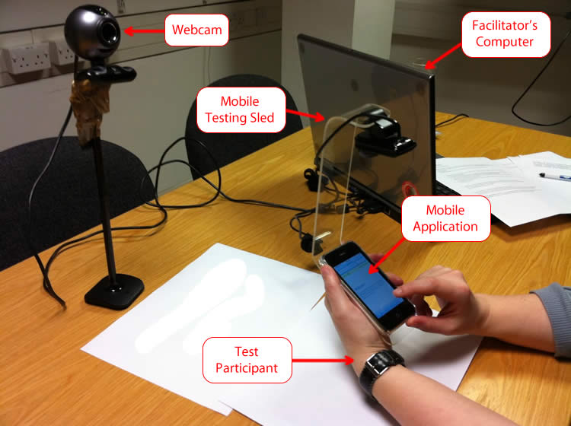
Usability Testing
Component of User Experience
Perform usability testing with actual users
Create audit report
Identify improvements

Slide 23
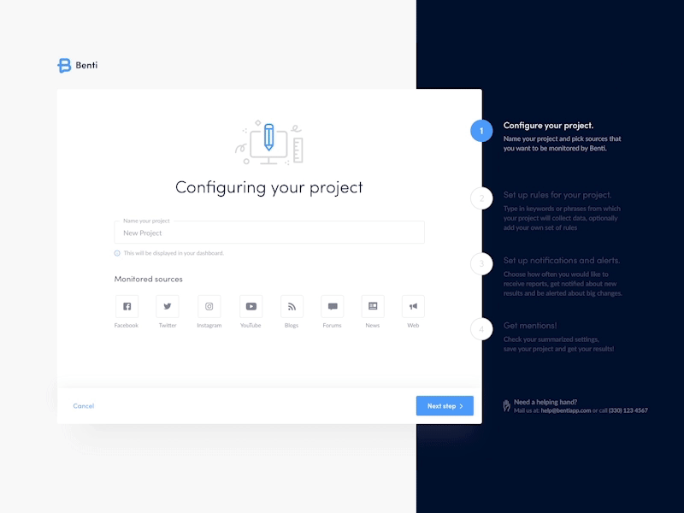
Interaction Design
Component of User Experience
How user will interact with your application
Ask “What will be easy for user”
Prototyping to define specific behaviors and functions for different components.
Source: Jakub Dziedzic

Slide 24
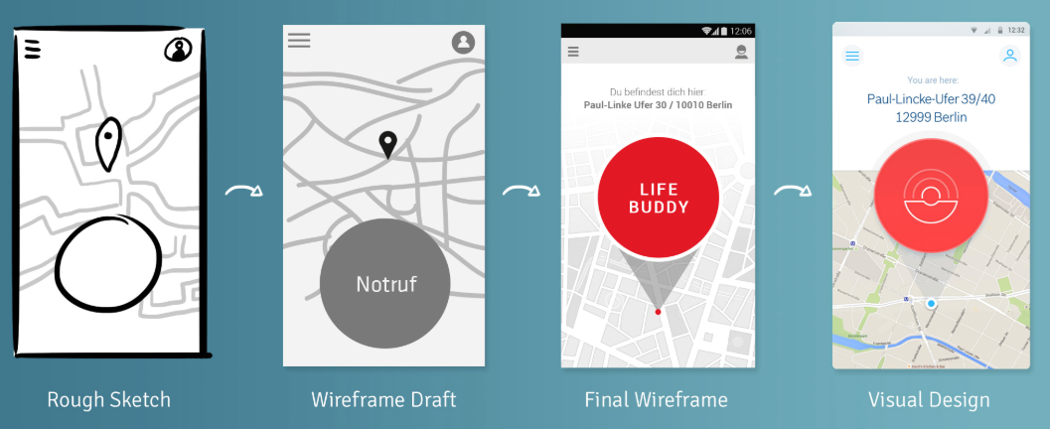
Visual Design
Component of User Experience
Design service at the structural level.
Convert wireframe to visual design
Prototype
Source: https://uxstepbystep.com

Slide 25
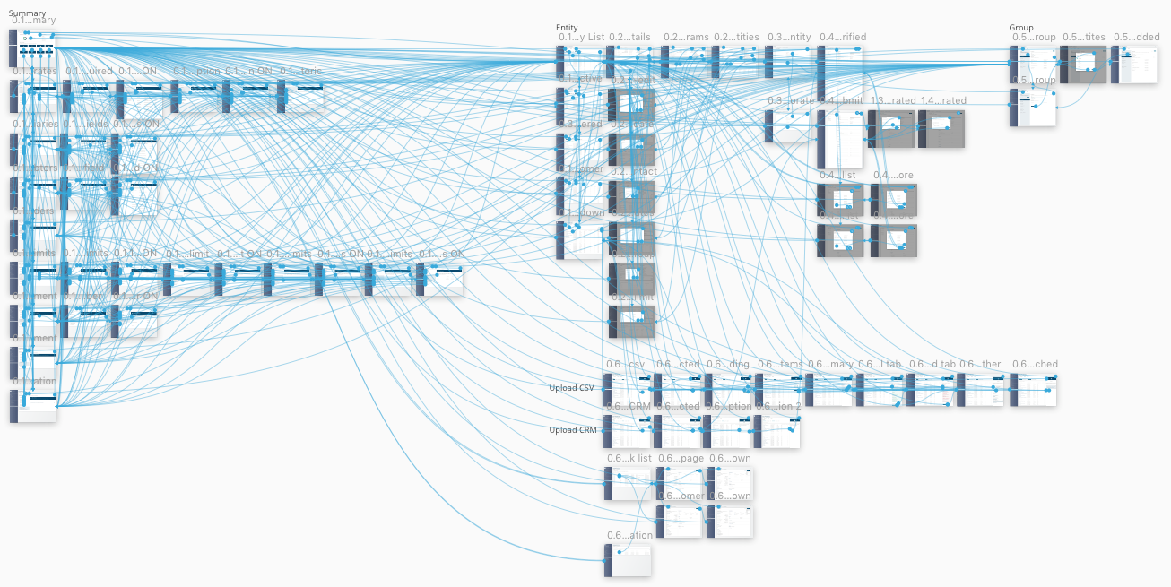
Prototyping
Component of User Experience
Way to set priorities
Cheaply test out options
Help testing final product functionality before investing time, resource and money into development

Slide 26


Slide 27


UX Architecture
Nayon Debnath Dipu
Assistant General Manager @ Bit Mascot

Slide 28

Who said what?
“Design is not just what it looks like and feels like. Design is how it works.” — Steve Jobs.

Slide 29

Who said this?
We believe that the most effective and ultimately the most profitable way to accomplish our mission is to put the needs of our users first. We have found that offering a high-quality user experience leads to increased traffic and strong word-of-mouth promotion.
We introduce new navigational and informational features when we believe they will be most useful to our users, and only after extensive usability testing and experimentation.
We believe that our user focus is the foundation of our success to date. We also believe that this focus is critical for the creation of long term value. We do not intend to compromise our user focus for short-term economic gain.
Google Annual Report 2009
Notes:
Larry Page and Sergey Brin both had taken usability classes in stanford

Slide 30
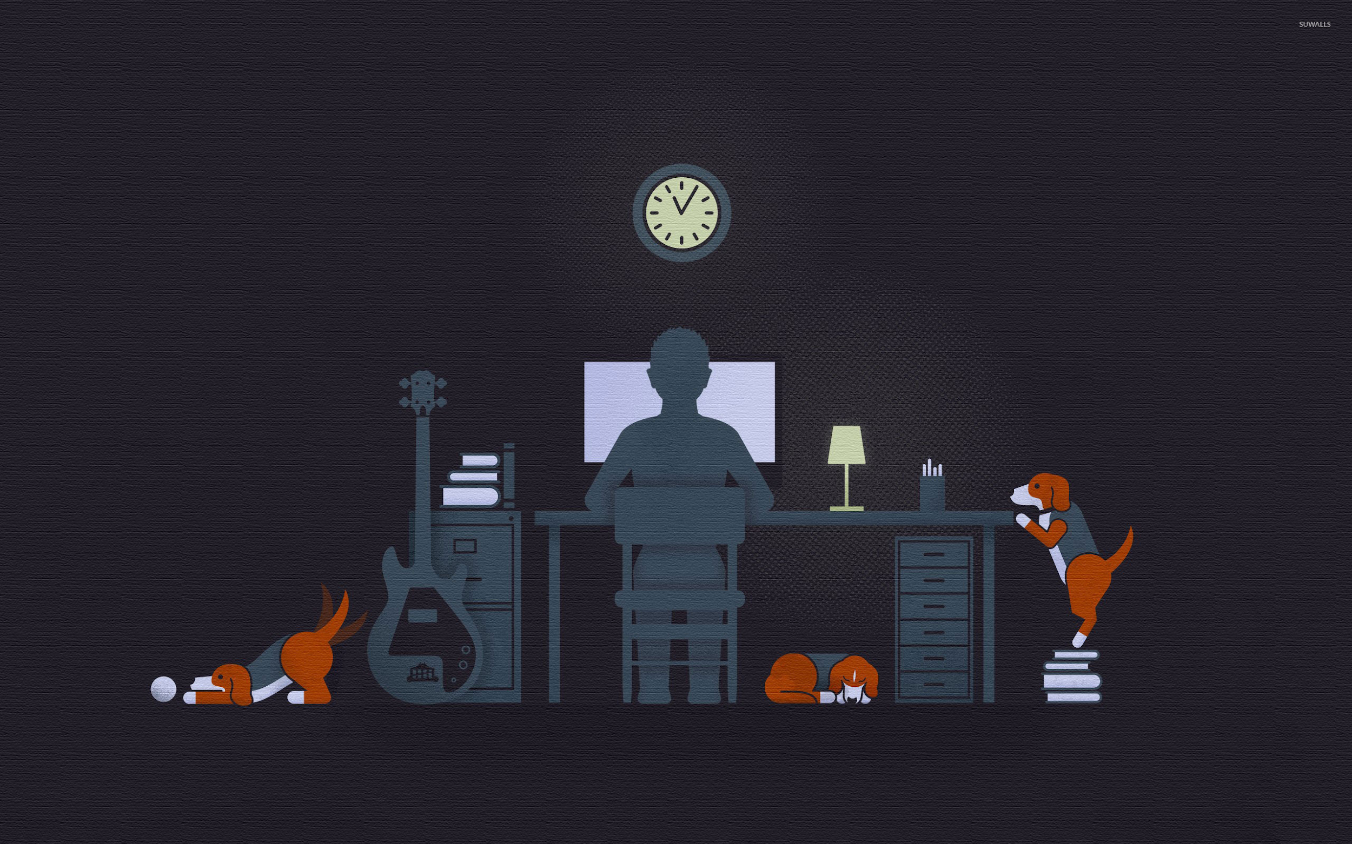
UX
Design Process

Slide 31
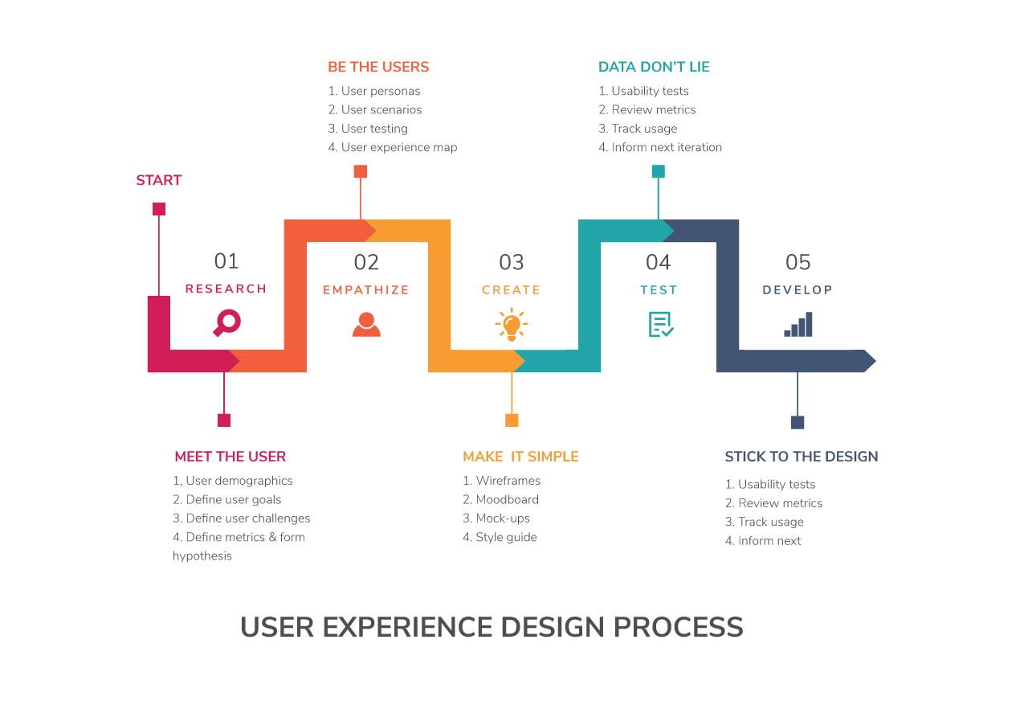
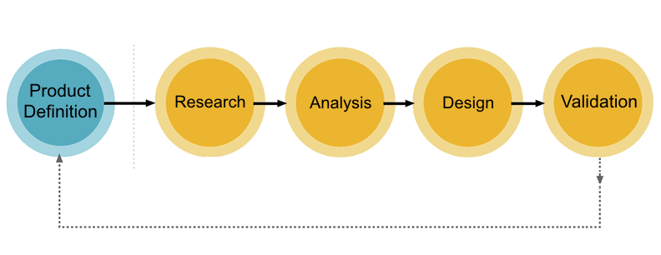
UX Process
As we all know now what are the components of UX. Now we are here to give you a taste of the UX methods used by UX designers when working on designing or redesigning a product, as well as show you the order in which specific UX steps should be taken. This process may differ slightly org to org or based on project length and type. But this process will help you a lot to get all UX components active and effective.
Courtesy: Adobe Blog
Source: Medium

Slide 32
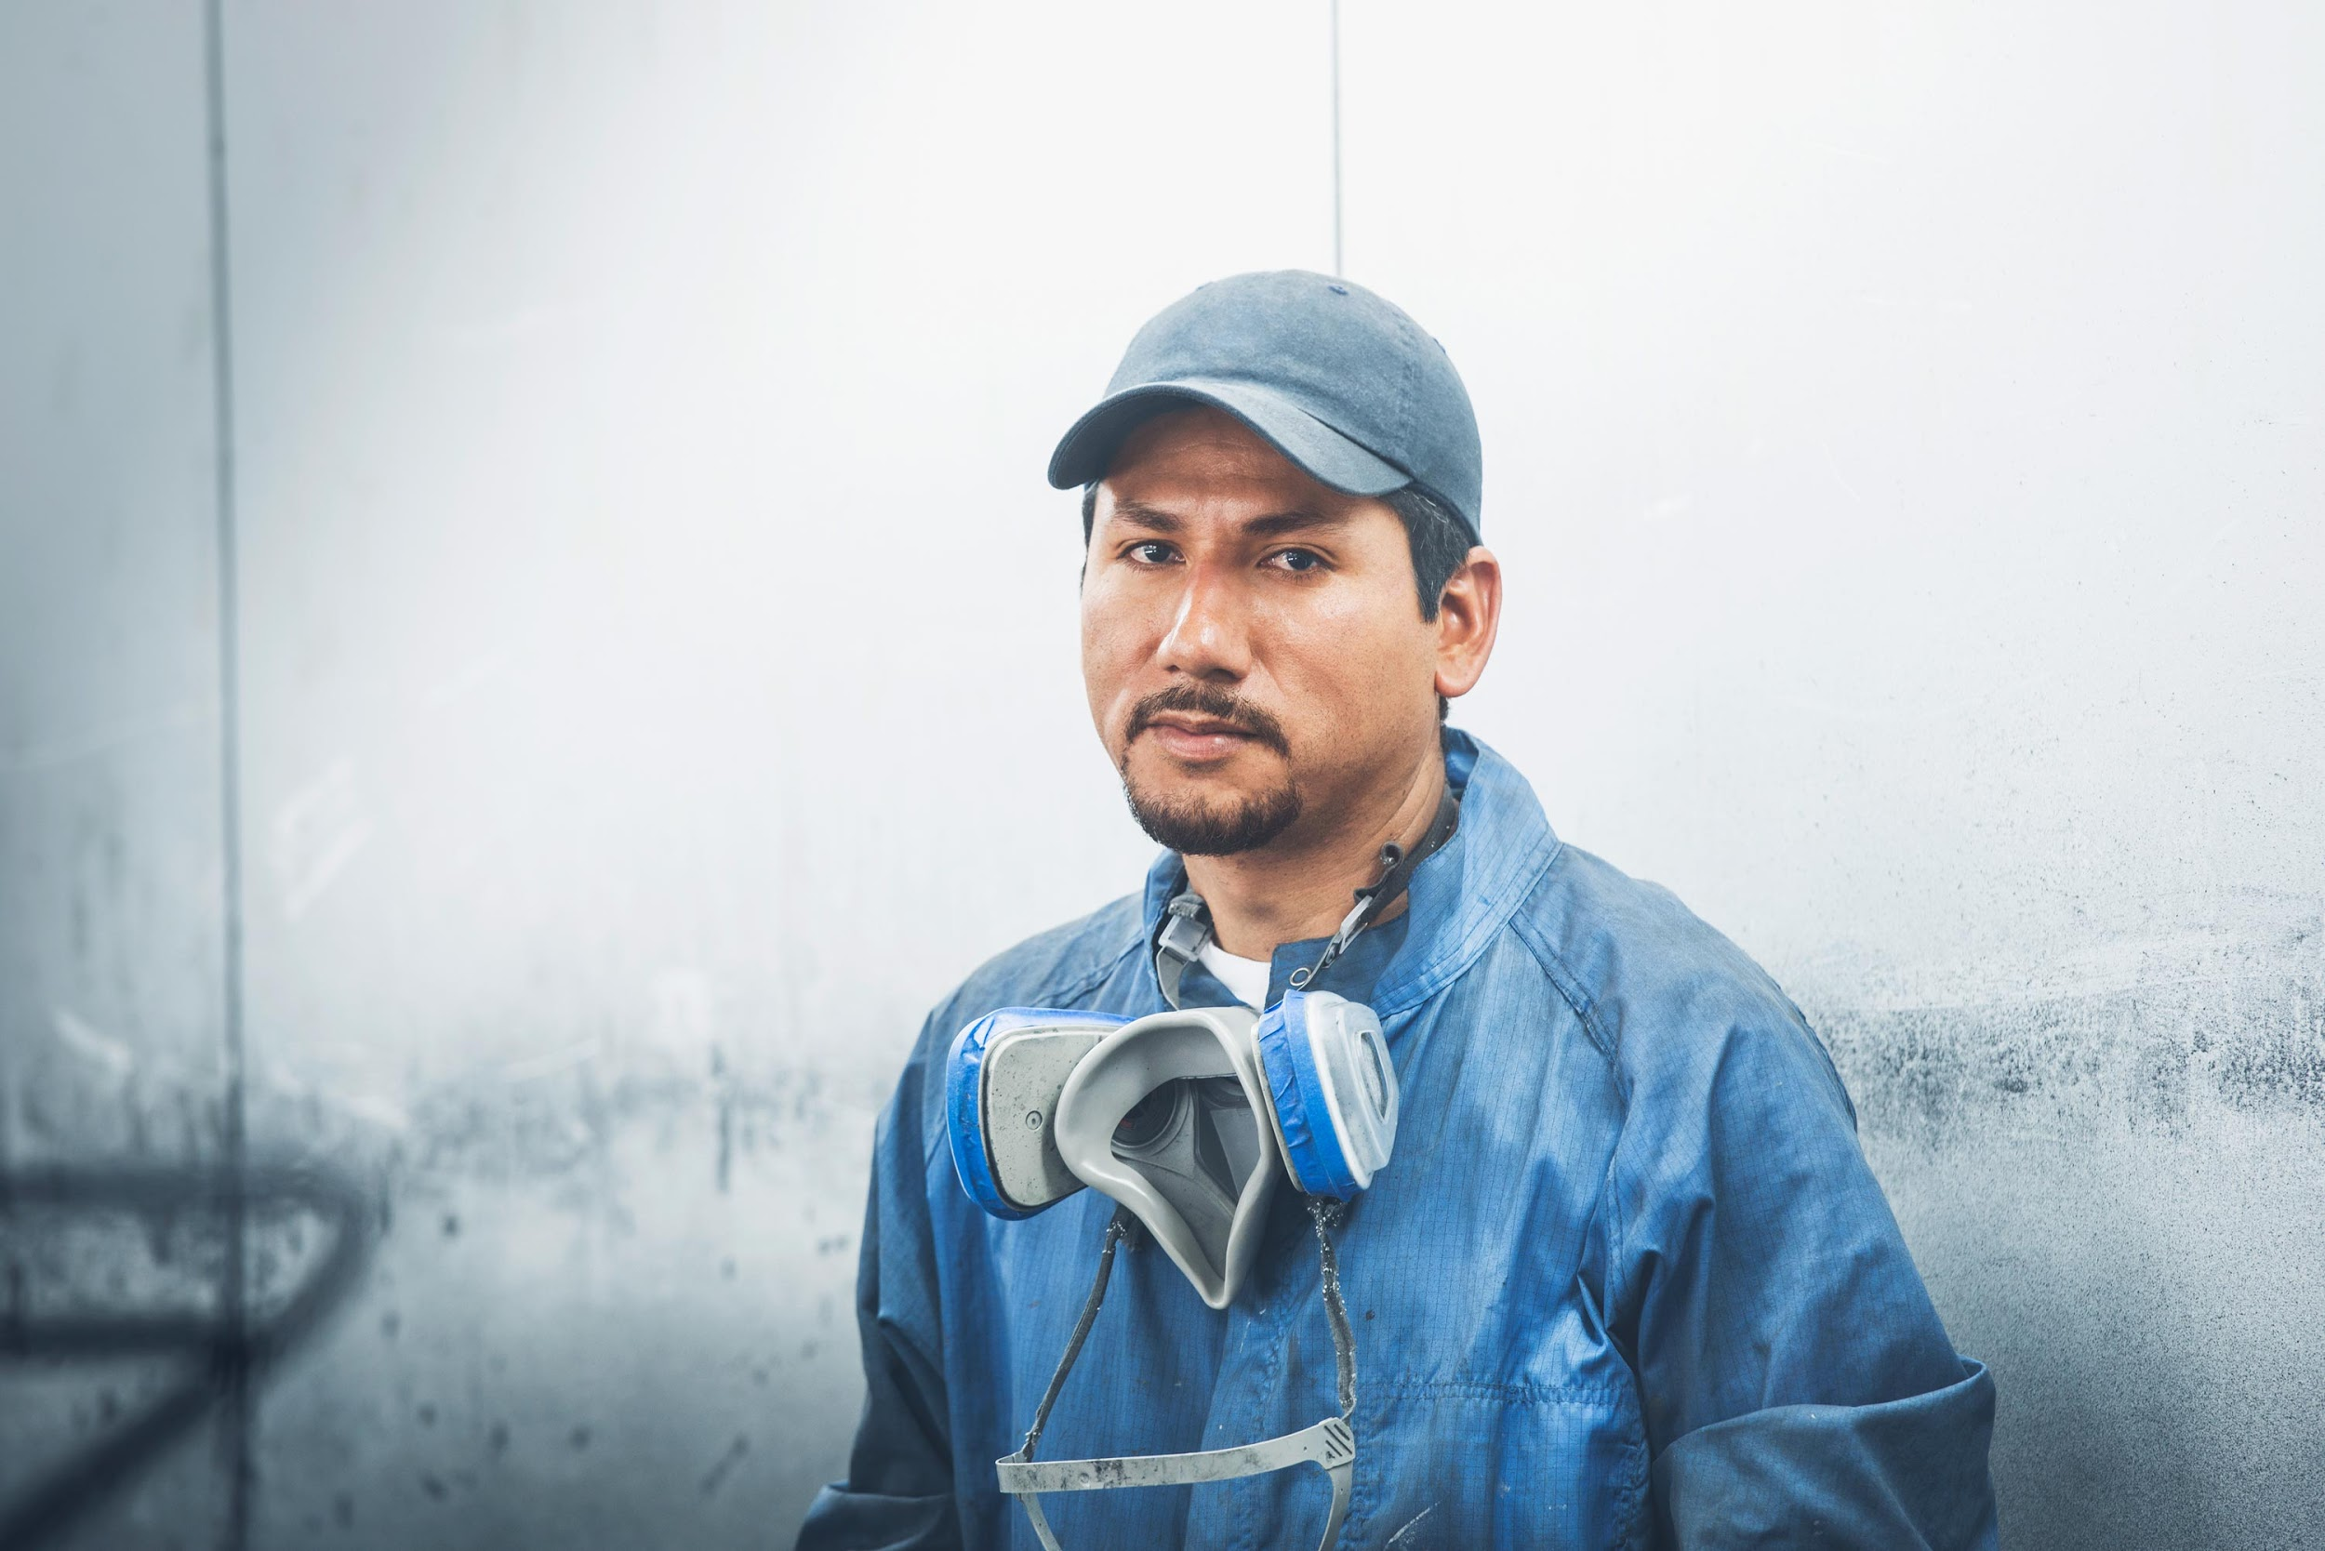

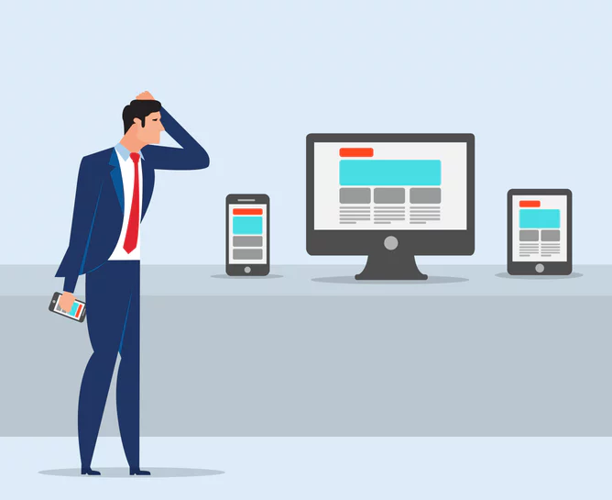
Meet the users
RESEARCH
User demographics
Define user goals
Define user challenges
Define metrics & form hypothesis

Slide 33


Be the users
EMPATHISE
User personas
User scenarios
User testing
User experience map

Slide 34
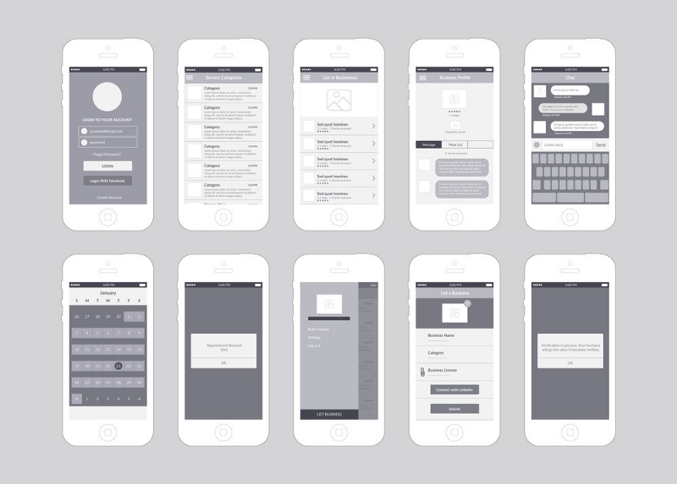
Make it Simple
CREATE
Wireframes
Moodboard
Mock-ups
Style guide
Source: Medium

Slide 35


Data don’t lie
TEST
Usability tests
Review metrics
Track usage
Inform next iteration

Slide 36

Develop UX
DEVELOP
Send iteration design to developers
Move to next iteration
Track progress
Answering questions

Slide 37

Incorporating UX into Agile

Slide 38
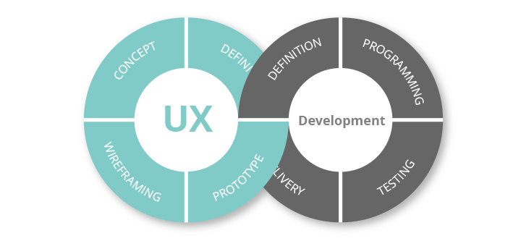
What is Agile UX?
Agile UX brings Agile software development together with the product and interaction design done by UX specialists. It embeds a UX expert on the Agile team and requires understanding and valuing the UX role. This means allotting time and budget for UX’s full process including research and testing.
Source: Justinmind

Slide 39
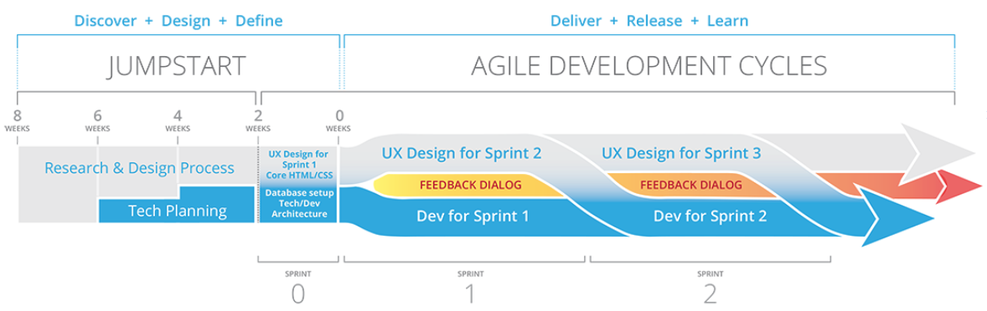
Agile UX Strategy
Design Sprint stays ahead of dev sprint
Design Guideline to be finished before kickoff
Sits after Product team and before Dev team
Source: Craigbachmanjr

Slide 40

UX for Everyone

Slide 41
UX for Everyone
1
Empathy The ability to understand why people behave the way they do. Putting yourself in other people’s shoes is essential to working in UX design.
2
Curiosity The desire to know why people behave the way they do.
Clarity of expression The ability to express complicated concepts clearly to those with little or no prior knowledge in the field.
3

Slide 42

Thank You

